Slide 1
Welcome to
Ulltrasafe
Security Screen Technical Information
intexconcepts.com

Slide 2
Windows - Face Fit – Checklist
Make sizes – Intex requires make sizes for all face fit applications.
Weep holes – are there weep holes that need to be considered? You cannot cover weep holes with a security screen.
Obstructions – Look out for pipes, rough bricks and trimmings that may obstruct the security screen. Look for quad at the top or render.
Distorted – Is the window distorted, bent or does it bow in the middle?
For the Fitters
Screws - Face fitting screens should always use security screw fixings. Note: because these are sold on the basis of their fixing strength, they should not be spaced wider than 300mm.
Inside fitting – Some face fit screens can be attached from the inside even though the screen may fitted from the outside or on the face. If this is the case, 2 fitters will be required so one can hold the screen on the outside while the other fixes it from the inside.

Slide 3
Windows - Reveal Fit – Checklist
Make sizes – Intex requires make sizes for all reveal fit applications.
Identify – Always try to identify the brand of the window (this can normally be found on the handle or on a sticker on the inside).
Determine – Has the window been designed to accommodate a reveal fit screen? Does it have channels for the screen to slide into.
Screen Size – Using your samples, determine if the channels are 9mm or 11mm.
Sliding Sash – Do you need to remove the sliding sash to measure and/or install the screen. If so, check that the sash can actually be taken out and that nothing is preventing this from happening.
Interlocks – Reveal fit screens are usually fixed from the inside with an interlock on the left and right-hand side. Interlocks will be supplied at the height of the screen and will need to be cut onsite.

Slide 4
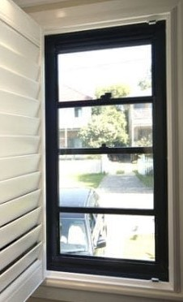
Different Window Types
Double Hung Windows – The only method to fit screens to on a double hung window is face fit.
Note: Is outside access possible not only for the screen to measured correctly but for ease of installation?
Note: Has the window manufacturer made provisions for a screen to be fitted, if not what is required to make it work?

Slide 5
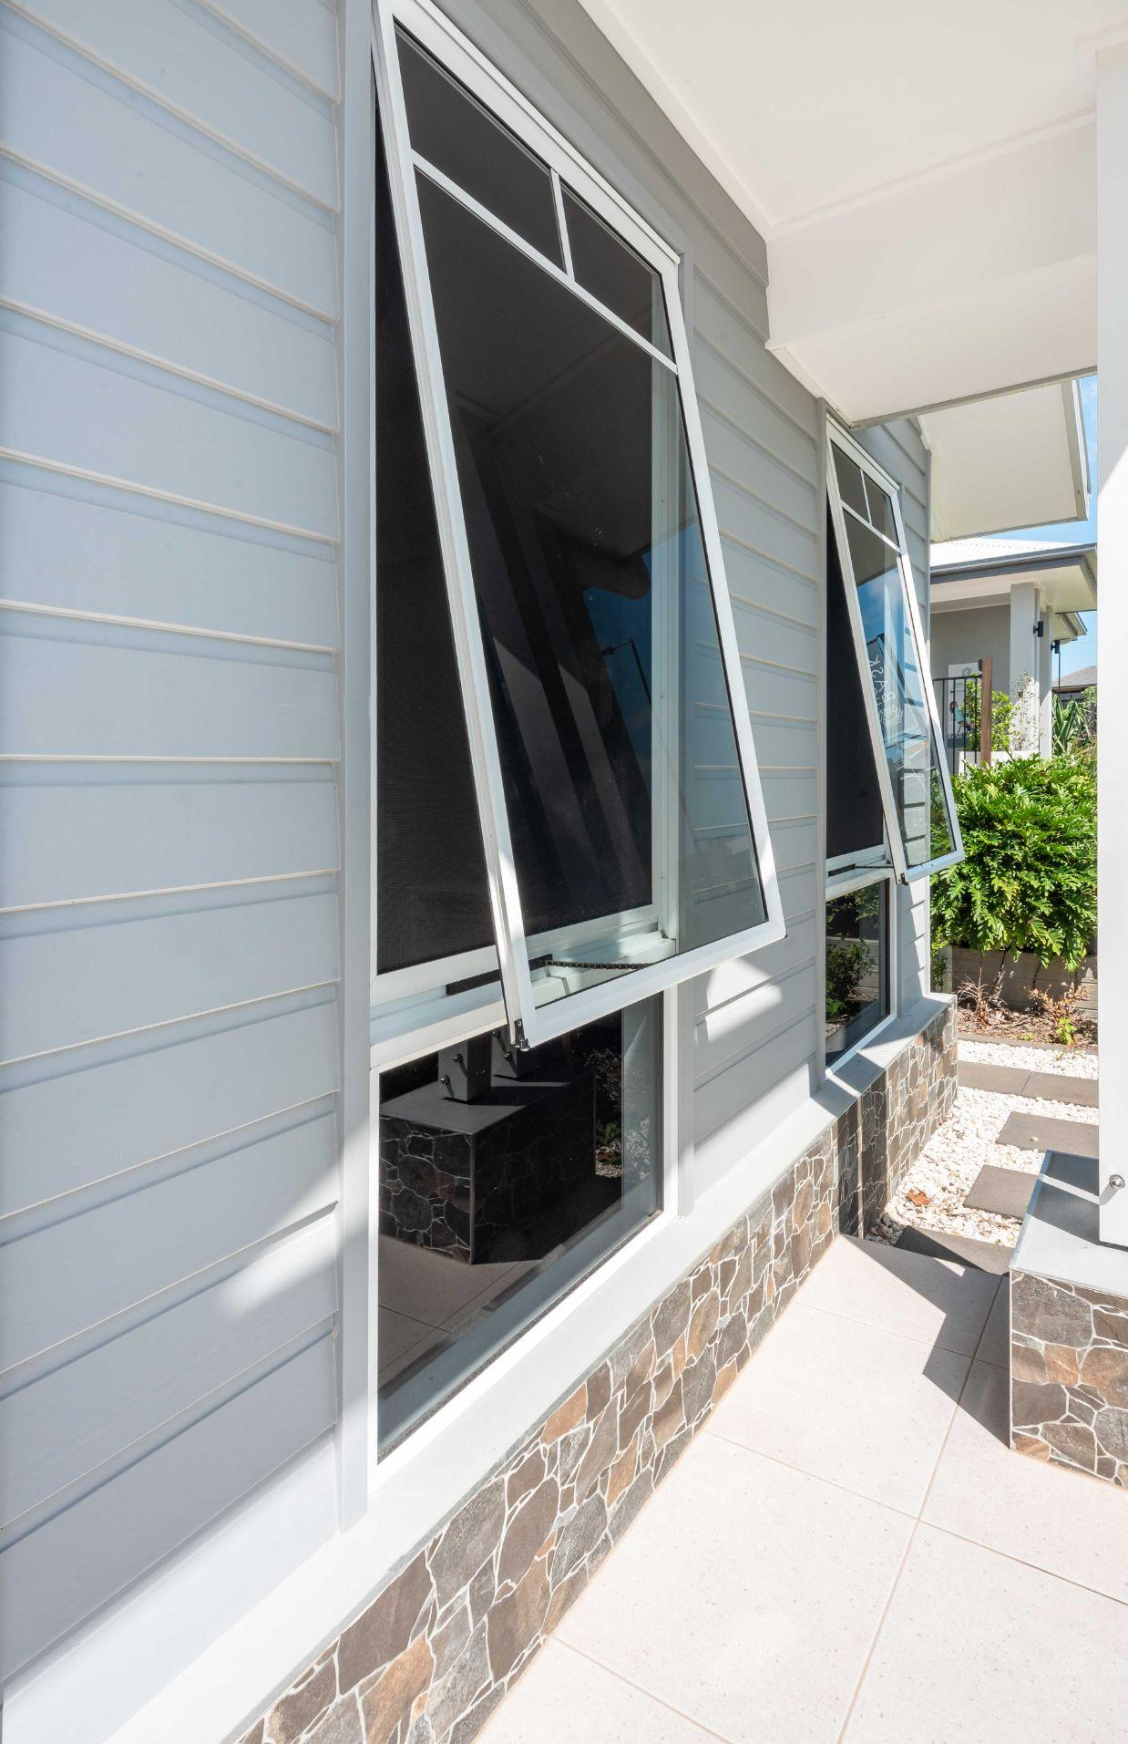
Different Window Types
Awning Windows
Note: What is the window made from: timber or aluminium?
Note: Has space been provided by the window manufacturer in which a screen can be installed? Is it possible to slip a screen in behind the winder?
Note: What angles are needed to seal the perimeter of the window? Are there adequate fixing points around the perimeter?

Slide 6
Standard Window Guide
A & L Windows – 9mm frame, 2 x small offset interlock
APL Windows – 9mm frame , 2 x flat interlock
Boral – 11mm frame, 2 x flat interlock
Bradman's – 9mm frame, 2 x flat interlock (Bradmans recommends face fit for all their windows)
Crane - 11mm frame, 2 x flat interlock
Crestlite – 11mm frame Face fit is the only option
Curtain – 11mm frame face fit but needs to be fitted from inside
Dowell - 11mm frame, 1 x flat interlock
G James – 11mm frame. Supply 25 x 12 angle @ 2 x height of screen (fix from inside by screwing through the angle, 2 fitters needed)
Langs - 11mm frame, 2 x large offset interlock
S & C – 11mm frame, fit from inside and outside.
Stegbar - 11mm frame Face Fit is the only option
Trend – 11mm frame, slip in from outside, fix from inside, 2 fitters needed
Vantage - 11mm frame, 2 x large offset interlock

Slide 7
Hinged Door – Checklist (part 1)
Jamb Depth - Ensure there is enough jamb to accommodate a security door. A minimum jamb width of 25mm is required to install a hinged security door on the existing door jamb. Particular note should be taken of the existing door furniture to make sure it does not encroach on the 25mm.
If the door jamb is less than 25mm, an adapter will be required. Note: Adapters should be fitted before you measure for the door.
Lock Height – Lock height to be provided on the order form is measured to the bottom of the lock ( locks are 180mm). Note: Ensure you do not align the lock with any existing door furniture that will obstruct the lock. Note: If you are replacing an existing screen, please provide the height of the centre of each mortice (aka the bolt recess/strike plate hole) so the locks align.
Door Opening – Doors are always measured from the outside looking in. Each door must be measured in 3 spots for the width (top, middle,bottom) and 3 spots for the height (left, middle, right). Note: it is good practice to measure the diagonals to determine how square the opening is. Note: A 2 metre spirit level is recommended.

Slide 8
Hinged Door – Checklist (part 2)
Obstructions – Check for anything that may prevent the door from opening: for example, a light fitting, a sloping floor or a roof line that comes into line with the swinging door. Always check the fascia.
Note: Do you require Stop Bead?
Bug Strips – These are provided in black and supplied loose to be fitted once the door is hinged.
Always - measure from OUTSIDE
Don’t hesitate to take photos or call and ask questions!

Slide 9
Sliding Door – Checklist (part 1)
Security – Where the door is required to be classed as a security door, specific tracks must be used to prevent jemmying and impact attacks. These tracks will have deep sides and contain a rounded edge (pip) for the wheels to run on.
Check the Depth – The existing side channel receiver should be no more than 20mm. If it is more than 20mm you will need to fit another receiver channel and this will become your new measuring point. The reason for this is the lock will not work if over 20mm.
Tracks – Check if your door can fit into the existing tracks and that the existing tracks have no dents in them so the rollers will run smoothly. If tracks are not there or dented you will need to add the new tracks before measuring.

Slide 10
Sliding Door – Checklist (part 2)
Lock Height – Locks are measured to the bottom of the lock (locks are 150mm). Note: Ensure you do not align the lock with any existing door furniture that will obstruct the lock. The screen door handle will project 23mm from the back of the screen and approx. 45mm with the key in the door. Note: If you are replacing an existing screen, please provide the height of the centre of each mortice (aka the bolt recess/strike plate hole) so the locks align.
Door Height – Always measure from Pip to Pip. Always measure in 3 places.
Door Width – Measure width from the inside of the existing (or added) receiver channel to the back edge of the existing door (note: where an existing interlock is present measure to the edge of the interlock).
Always - measure from OUTSIDE

Slide 11
Technical Videos
https://www.youtube.com/watch?v=RQy_AZ86rZ4
https://www.seconline.com.au/diy-info-centre/measure-sliding-stacker-screen-doors
https://www.seconline.com.au/diy-info-centre/install-sliding-stacker-screen-doors
https://screenwarehouse.com.au/diy-info-center/sliding-doors-diy-center/sliding-door-measurement/
https://www.onlinesecurityscreens.com.au/hingedsecuritydoors

